Slide 1
Lab 2
Introduction to Programming
Using Dev C++

Slide 2
Topics to Be Covered
Program
Different Programming Languages
Introduction to C++
Programming Environment
First C++ Code

Slide 3

Computer is a dumb machine.
To control the computer or any other hardware for desired functionality, we develop software/programs.
Computer programs are a set of instructions.
We need to learn programming languages to write these programs.

Slide 4
Computer Languages
Machine Language
Uses binary code
Machine-dependent
Not portable
Assembly Language
Uses mnemonics
Machine-dependent
Not usually portable
High-Level Language (HLL)
Uses English-like language
Machine independent
Portable (but must be compiled for different platforms)
Examples: Pascal, C, C++, Java, Fortran

Slide 5
Overview of C++
In simple terms, C++ is a sophisticated, efficient and a general-purpose programming language and is middle level programming language based on C.
It was developed by Bjarne Stroustrup in 1979.
Many of today’s OS, system Drivers, browsers and games used C++
C++ gives programmers a high level of control over system resources and memory.
Graphical User Interfaces and embedded systems.
C++ is used in many applications like
Adobe Products like Photoshop, Illustrator, In Design
Amazon - one of the biggest e-commerce sites
Autodesk products for Computer Aided Design
Facebook - social networking site are heavy C++ centric products.

Slide 6
Programming Environment
DEV C++:
DEV C++ is developed by Bloodshed software.
Dev-C++ is a free full-featured integrated development environment (IDE) which is free, portable, fast and simple in use.
As similar IDEs, it offers to the programmer a simple and unified tool to edit, compile, link, and debug programs.
It also provides support for the management of the files of a program in “projects” containing all the elements required to produce a final executable program.

Slide 7

 C++ systems generally consist of three parts:
a program development environment (IDE)
the language and
the C++ Standard Library.
C++ programs typically go through six phases:
edit,
preprocess,
compile,
link,
load and
execute

Slide 8
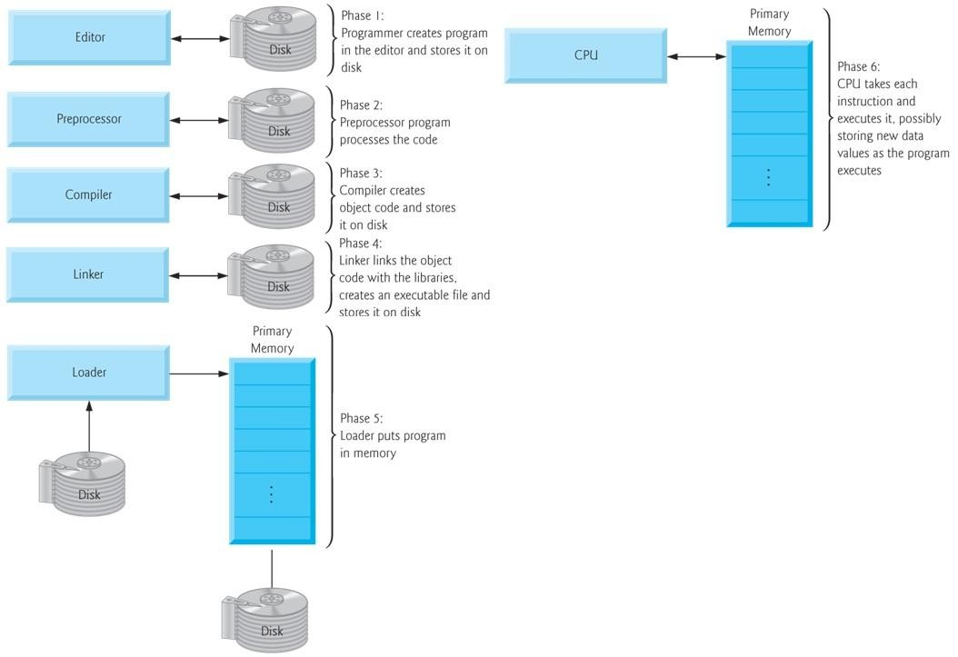

Slide 9
 Phase 1- Editor
Type a C++ program (source code) using the editor.
Save the program.
C++ source code filenames often end with the .cpp,
.cxx, .cc or .C extensions (note that C is in uppercase) which indicate that a file contains C++ source code.
Examples of Editors
Linux – vi, emacs
Microsoft Windows – Microsoft Visual C++
Simple editors like Notepad

Slide 10
 Phase 2 – preprocessor
The C++ preprocessor obeys commands called preprocessor directives, which indicate that certain manipulations are to be performed on the program before compilation.
These manipulations usually include other text files to be compiled, and perform various text replacements.
In Phase 3 – compiler
It translates the C++ program into machine- language code -also referred to as object code.

Slide 11
 Phase 4 – linking
The object code produced by the C++ compiler typically contains ―holes‖ due to these missing parts.
A linker links the object code with the code for the
missing functions to produce an executable program.
Phase 5 – loading
Before a program can be executed, it must first be placed in memory.
The loader takes the executable image from disk and transfers it to memory.
Additional components from shared libraries that
support the program are also loaded.

Slide 12
 Phase 6 - Execution
Finally, the computer, under the control of its CPU, executes the program one instruction at a time.
Some modern computer architectures can execute several instructions in parallel.
Problems that may occur at execution
If problem occurs, you have to return the editor phase, make necessary corrections and proceed with rest of the phases.

Slide 13
Download Dev C++ From:
https://sourceforge.net/projects/orwelldevcpp/files/latest/download

Slide 14
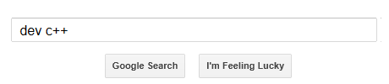
Where to Download the C++ Software
To download, the necessary software to run C++ code, go to the website: http://www.bloodshed.net/devcpp.html.
Or go to google and type in dev C++:

Slide 15
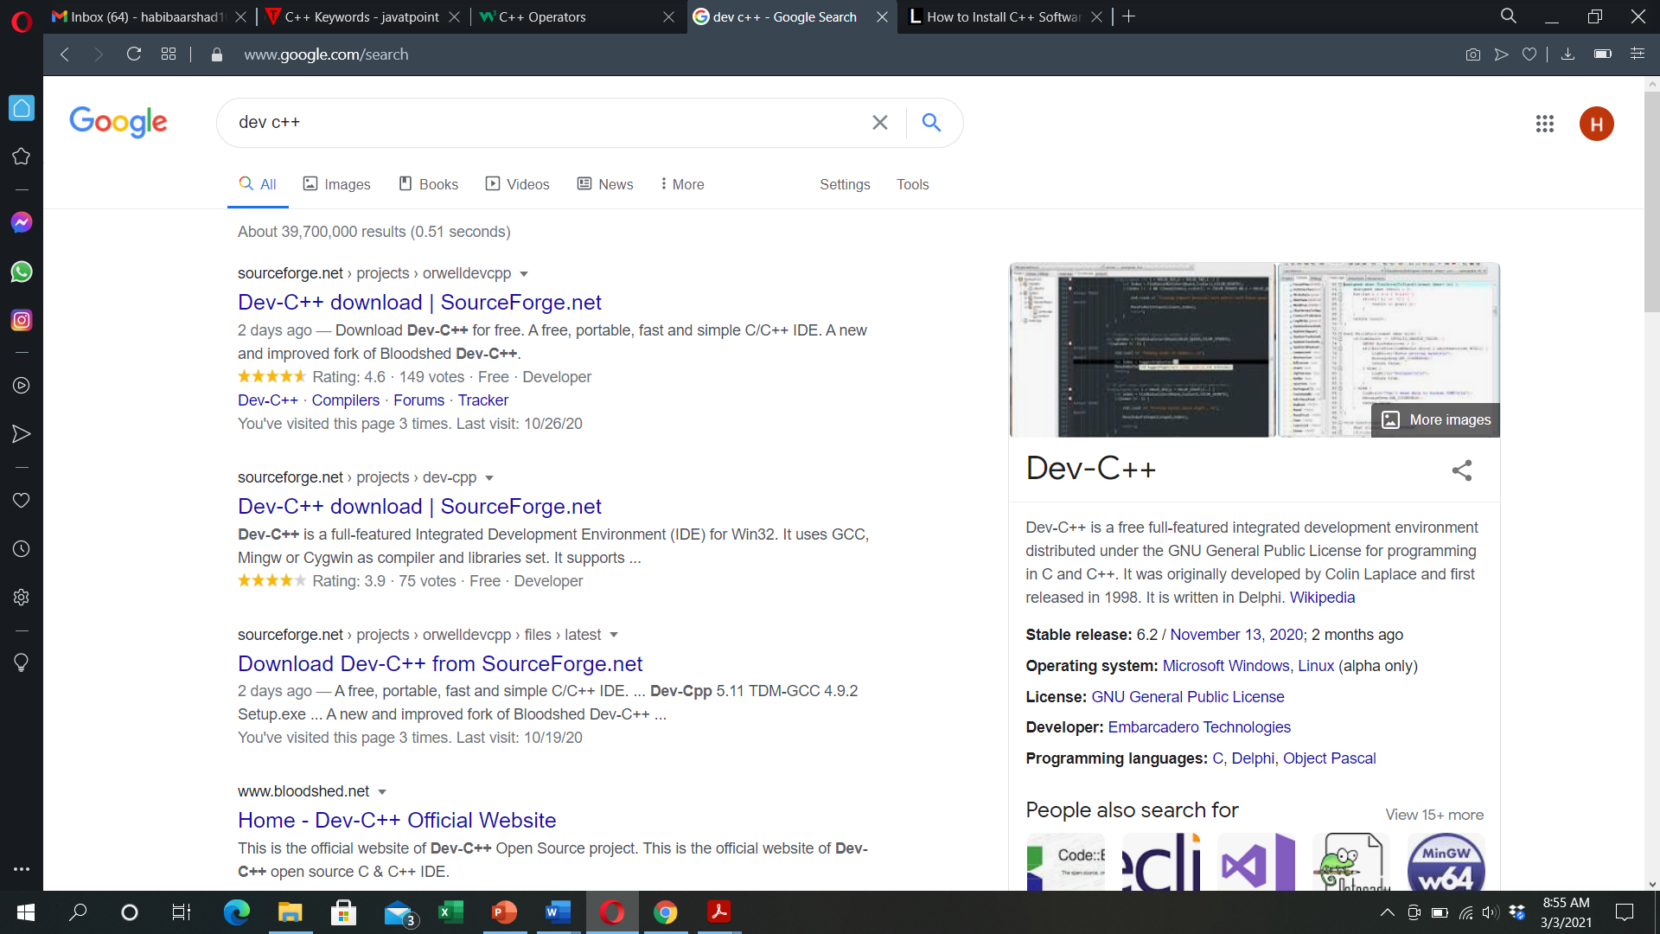
Click on any one of the following link

Slide 16
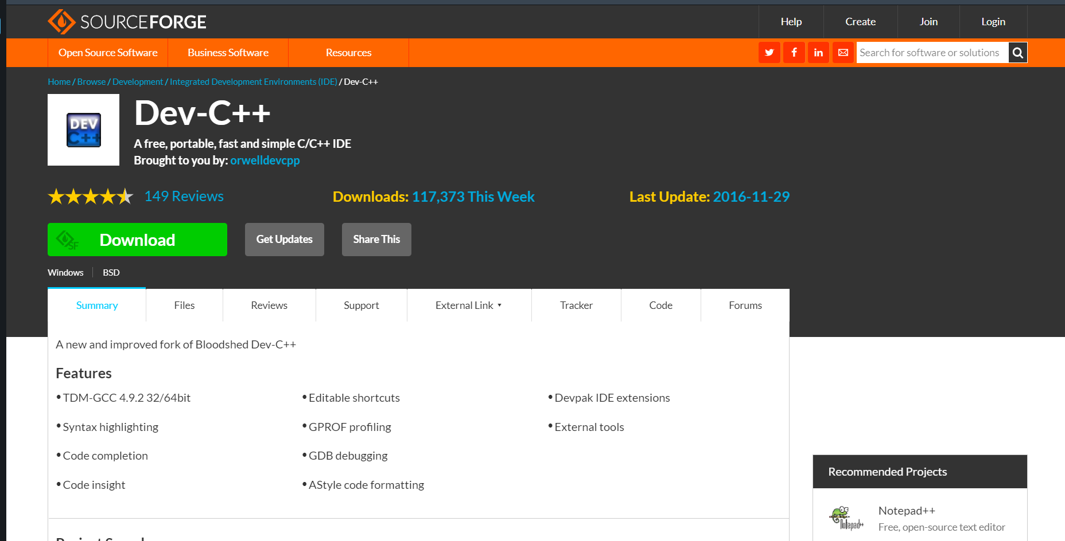
Click on Download to download .exe file

Slide 17
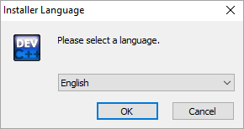
Dev C++ Installation
Click on downloaded .exe file
The first step while we start the installer is to select the language of our choice as shown in the below screenshot.
Click OK

Slide 18
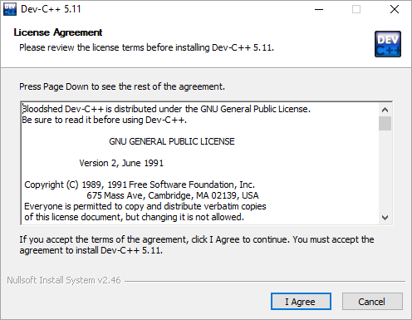
Once you select the appropriate language, you have to agree to the license agreement that pop-ups next.
Click I Agree

Slide 19
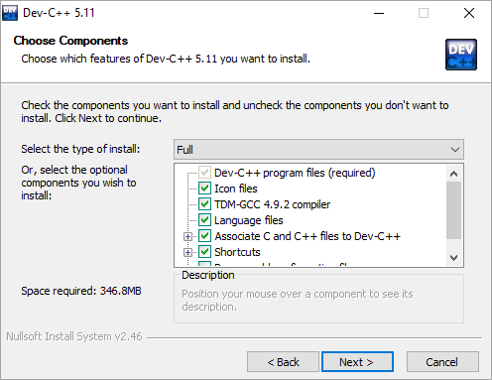
Next, we are asked to select the components that we need to install as a part of the dev-C++ installation.
Click Next

Slide 20
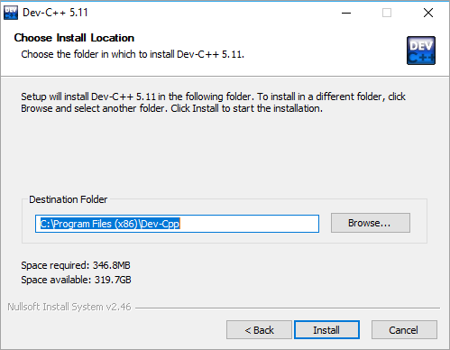
Now the installer prompts the user for the destination folder where the dev-C++ files/libraries etc. are to be copied.
Click Install

Slide 21
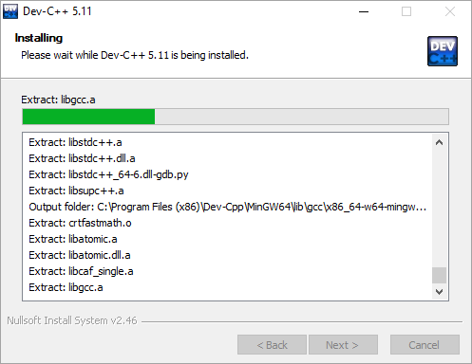
The following screenshot shows the progress of the installation.

Slide 22
Once the installation is over, a “finish” dialog that signals the end of the installation appears. We click finish and then we can launch the dev-C++ IDE.
Now let’s see the working of this C++ IDE in detail.

Slide 23
Why using C++?
C++ is a cross-platform language that can be used to create high-performance applications. It gives programmers a high level of control over system resources and memory.
C++ is one of the world's most popular programming languages.
C++ can be found in today's operating systems, Graphical User Interfaces, and embedded systems.
C++ is an object-oriented programming language which gives a clear structure to programs and allows code to be reused, lowering development costs.
C++ is portable and can be used to develop applications that can be adapted to multiple platforms.
C++ is fun and easy to learn!
As C++ is close to C# and Java, it makes it easy for programmers to switch to C++ or vice versa

Slide 24
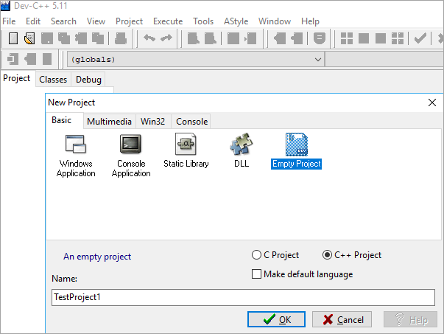
Development Using Dev-C++ IDE
Create A New Project
To create a new project in dev-C++ we need to follow the below steps:
Click File -> New -> Project.
A new dialog opens up as shown below.

Slide 25
Here, we can specify the project name. Make sure to select the “Empty Project” and also to check the “C++ Project” button.
Once the entire information is provided, we can click ok and the IDE will ask for the path where the project is to be saved. When this is done, a workspace will open with the project explorer on the left-hand side that shows the project we just created.
Now we can add or import the code files into this project.

Slide 26
Add Source File(s)
Adding a file to a project can be done in two ways.
Add a new file by clicking Project ->New File or Right-click on Project Name in the project explorer and click New File.
Another way is to add the existing files to the project. This can be done by clicking Project ->Add to Project or right-click on Project Name in the project explorer and select “Add to Project…” This will give a dialog to select files and import them to the project.
Once the files are added to the project, the workspace looks as shown in next slide.

Slide 27
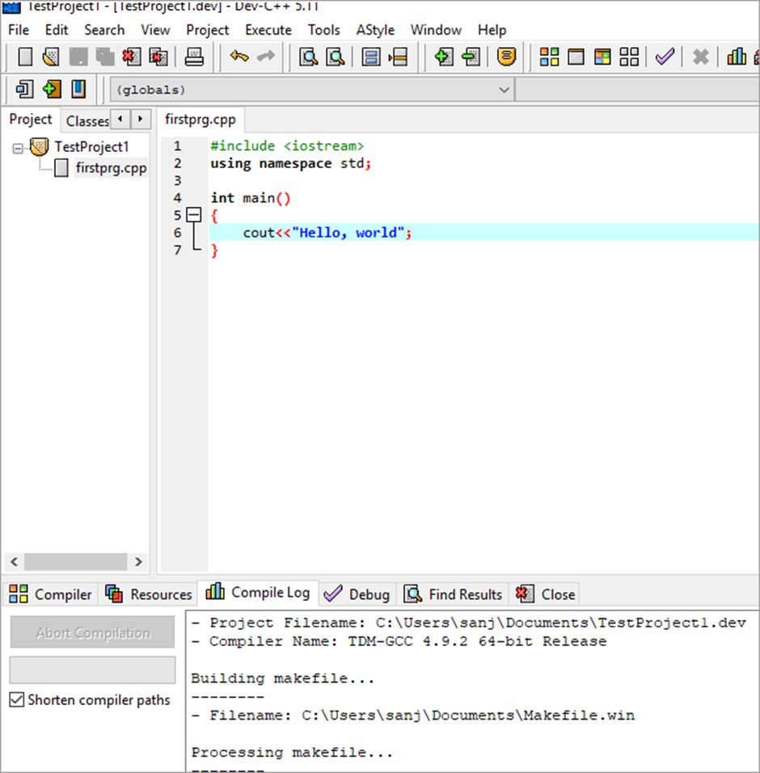

Slide 28
Compile/Build & Execute Project
When we have all the code ready for the project, we will now compile and build the project.
Follow the below steps to build and execute the dev C++ project:
To compile the project, click Execute -> Compile (or click F9).
We can see the compilation status in the “Compile Log” tab in the workspace.
If there are any errors whether syntax or linker errors, then they will appear in the compiler tab.
Once the project is compiled successfully, we need to run it.
Click on Execute ->Run.( or click F10)
The console window that gives us the output will be shown in the below screenshot.

Slide 29
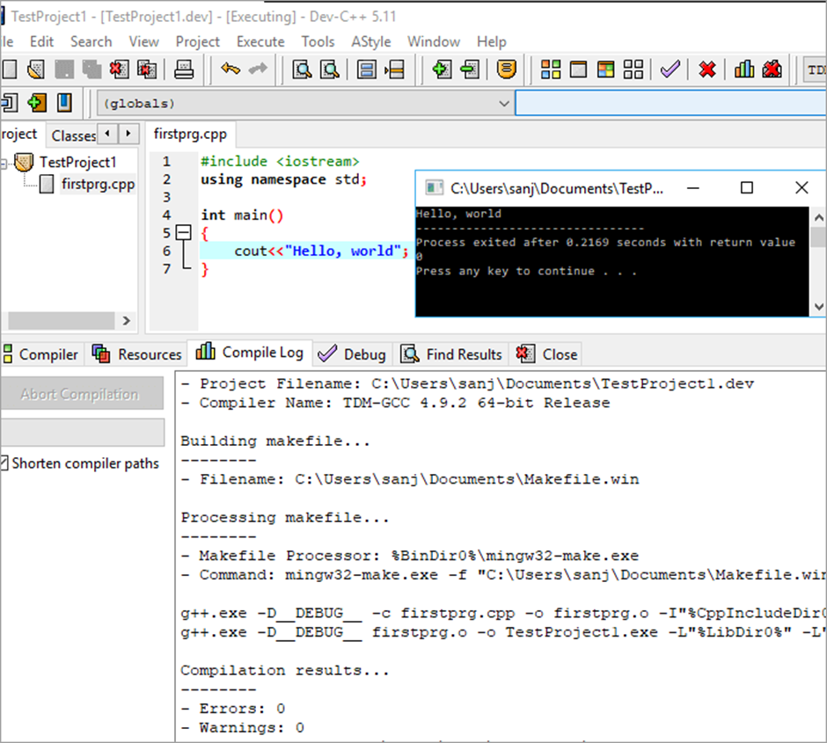

Slide 30
Debugging In C++ IDE
Sometimes we may not get the desired output from our program although the program is syntactically correct. In such a situation, we can debug the program. The dev-C++ IDE provides the inbuilt debugger.
Follow the below steps to debug the program using Dev-C++ IDE:
Click Execute ->Debug. (or click F5).
Once the debug is clicked, we get the debug menu in the IDE, as shown below.
Before debugging we can toggle breakpoints using F4 at a particular line of code.
Using the debug menu, we can use options like add watches, run to cursor, into function, etc. to efficiently debug our program.

Slide 31
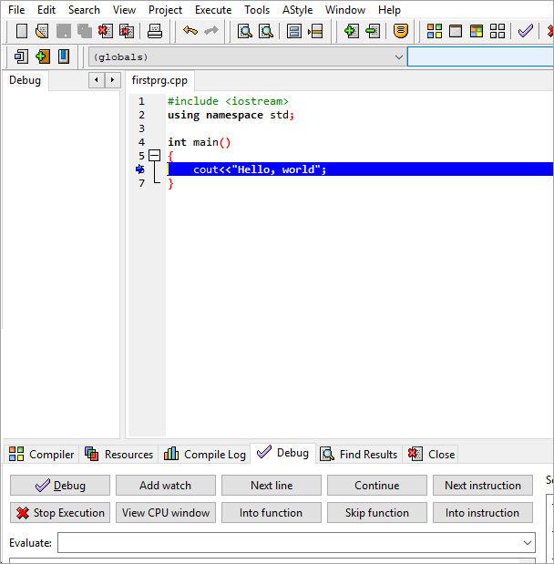

Slide 32
Basic C++ Coding using Cout and Escape Sequences

Slide 33
C++ Program Structure
A C++ program consists of three parts:
Preprocessor Directives
Main() function
C++ statements

Slide 34
Preprocessor directive that tells the processor to include I/O library in C++
// a first program in c++.
#include <iostream>
using namespace std;
// function main begins program execution
int main()
{
cout << "welcome to c++!\n";
return 0; // indicate that program ended successfully
} // end function main
All the elements of the standard C++ library are declared within what is called a namespace, the
namespace with the name std.
Main function
C++ Statements
Welcome to C++!

Slide 35
Structure of a program
Probably the best way to start learning a programming language is by writing a program. Therefore, here is our first program:
// my first program in C++
#include <iostream>
using namespace std;
int main ()
{
cout << "Hello World!";
return 0;
}
Hello World!

Slide 36
It is one of the simplest programs that can be written in C++, but it already contains the fundamental components that every C++ program has. We are going to look line by line at the code we have just written:

Slide 37
// my first program in C++
This is a comment line.
All lines beginning with two slash signs (//) are considered comments and do not have any effect on the behavior of the program.
The programmer can use them to include short explanations or observations within the source code itself.
In this case, the line is a brief description of what our program is.

Slide 38
#include <iostream>
Lines beginning with a hash sign (#) are directives for the preprocessor.
They are not regular code lines with expressions but indications for the compiler's preprocessor.
In this case the directive #include<iostream> tells the preprocessor to include the iostream standard file.
This specific file (iostream) includes the declarations of the basic standard input-output library in C++, and it is included because its functionality is going to be used later in the program.
Notes:
Important Header files in C++
Some library Files and where to use them:
<iostream>
Provides C++ input and output fundamentals. See iostream.
<iomanip>
Provides facilities to manipulate output formatting, such as the base used when formatting integers and the precision of floating point values.
<math.h>
math.h header file supports all the mathematical related functions in C language.
<string.h>
Use for all string functions

Slide 39
using namespace std;
All the elements of the standard C++ library are declared within what is called a namespace, the namespace with the name std.
So in order to access its functionality we declare with this expression that we will be using these entities.
This line is very frequent in C++ programs that use the standard library, and in fact it will be included in most of the source codes included in these tutorials.

Slide 40
int main ()
This line corresponds to the beginning of the definition of the main function.
The program consists of a single function main()
main() is called the entry point of any C++ program as the control always go to main() on startup.
Without the main() in your program, an error will be generated.

Slide 41
cout << "Hello World!";
This line is a C++ statement.
A statement is a simple or compound expression that can actually produce some effect.
In fact, this statement performs the only action that generates a visible effect in our first program.
cout represents the standard output stream in C++, and the meaning of the entire statement is to insert a sequence of characters (in this case the Hello World sequence of characters) into the standard output stream (which usually is the screen).
cout is declared in the iostream standard file within the std namespace, so that's why we needed to include that specific file and to declare that we were going to use this specific namespace earlier in our code.
Notice that the statement ends with a semicolon character (;). This character is used to mark the end of the statement and in fact it must be included at the end of all expression statements in all C++ programs (one of the most common syntax errors is indeed to forget to include some semicolon after a statement).

Slide 42
return 0;
The return statement causes the main function to finish.
return may be followed by a return code (in our example is followed by the return code 0).
A return code of 0 for the main function is generally interpreted as the program worked as expected without any errors during its execution.
This is the most usual way to end a C++ console program.

Slide 43
Lab Tasks
Write a program to print your “name”,” country”, and “gender”.

Slide 44
Escape Sequences
Escape Sequences Characters \b Backspace \f Form feed \n Newline \r Return \t Horizontal tab \v Vertical tab \\ Backslash \' Single quotation mark \" Double quotation mark \? Question mark \0 Null Character
Sometimes, it is necessary to use characters that cannot be typed or has special meaning in C++ programming. For example, newline (enter), tab, question mark, etc. In order to use these characters, escape sequences are used.

Slide 45
Try the following and note the actions performed by the escape sequences using comments
cout <<“welcome \n to \n C++”; // new line
cout <<“welcome \t to \t C++”;
cout<<“welcome \r to \r C++”;
cout<<“program end \a”;
cout<<“Select D: \\ drive”;
cout<<“welcome to \‟ programming\‟ ”;
cout<<“welcome to \” programming \” ”;

Slide 46

Lab Task
Display shapes using single cout statement?
1
1 2
1 2 3
1 2 3 4
1 2 3 4 5

Slide 47
Data Types
A variable provides us with named storage that our programs can manipulate.
Each variable in C++ has a specific type, which determines the size and layout of the variable's memory, this type is known as data type of that variable.
The name of a variable can be composed of letters, digits, and the underscore character. It must begin with either a letter or an underscore. Upper and lowercase letters are distinct because C++ is case-sensitive.

Slide 48
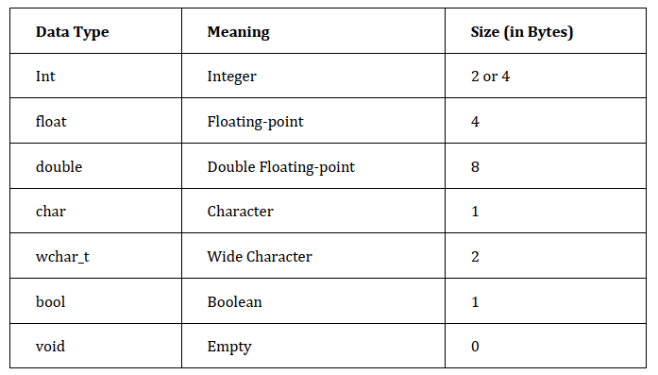
Data Types

